Slide 1



Management Practices in Europe, the US and Emerging Markets
Nick Bloom (Stanford Economics and GSB)
John Van Reenen (LSE and Stanford GSB)
Lecture 8: Management in India and China

Slide 2
In the last class I want to cover two things
China and India: I will present two sets of slides on firms in China and India, and Rewant will talk about Essar
Experiments: Focusing on two themes:
  Best practice for research on management (moving beyond case-studies and surveys)
  How firms can learn (Evidence Based Management)

Slide 3
Experiments in India
Experiments in China

Slide 4

Does management matter?
Evidence from India
Nick Bloom (Stanford)
Benn Eifert (Berkeley)
Aprajit Mahajan (Stanford)
David McKenzie (World Bank)
John Roberts (Stanford GSB)

Slide 5
One motivation for looking at management is that country management scores are correlated with GDP
US
Japan
Germany
Sweden
Canada
Australia
UK
Italy
France
New Zealand
Mexico
Poland
Republic of Ireland
Portugal
Chile
Argentina
Greece
Brazil
China
India
2.6
2.8
3
3.2
3.4
Management score
Random sample of manufacturing population firms 100 to 5000 employees.
Source: Bloom & Van Reenen (2007, QJE); Bloom, Genakos, Sadun & Van Reenen (2011, AMP)

Slide 6
Firm management spreads like productivity spreads
US (N=695 firms)
Density
India (N=620 firms)
Density
Management score

Slide 7
But does management cause any of these productivity differences between firms and countries?
Massive literature of case-studies and surveys but no consensus
Syverson (2011, JEL) “no potential driving factor of productivity has seen a higher ratio of speculation to empirical study”.
Notes:
Note ISP, CN and BL are the only three papers using panel data to estimate management effects including plant fixed effects. ISP find a significant positive effect in a small but very well measured sample of data from 36 lines in 17 steel plants, while Black and Lynch and Cappelli and Neumark find nothing significant (or large in terms of the point estimate) using two waves of a noiser but larger (766 panel observation) Census survey of manufacturing.

Slide 8
So we run an experiment on large firms to evaluate the impact of modern management on productivity
Experiment on 20 plants in large multi-plant firms (average 300 employees and $7m sales) near Mumbai making cotton fabric
Randomized treatment plants get 5 months of management consulting intervention, controls get 1 month
Consulting is on 38 specific practices tied to factory operations, quality and inventory control
Collect weekly data on all plants from 2008 to 2010.

Slide 9
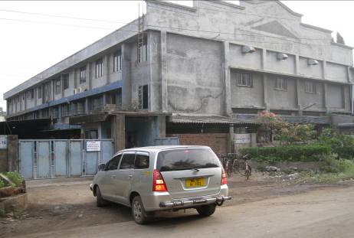
Exhibit 1: Plants are large compounds, often containing several buildings.

Slide 10
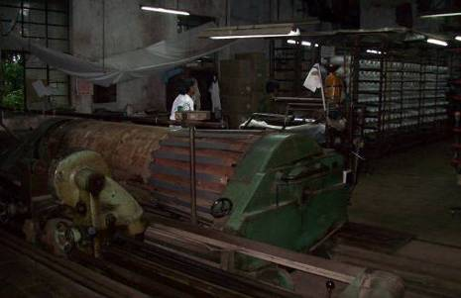
Exhibit 2a: Plants operate continuously making cotton fabric from yarn
Fabric warping

Slide 11
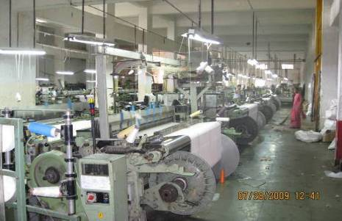
Exhibit 2b: Plants operate continuously making cotton fabric from yarn
Fabric weaving

Slide 12
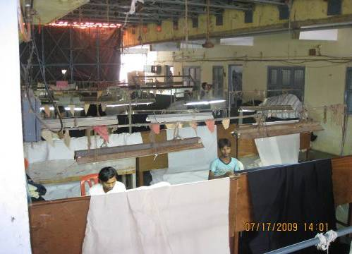
Exhibit 2c: Plants operate continuously making cotton fabric from yarn
Quality checking

Slide 13
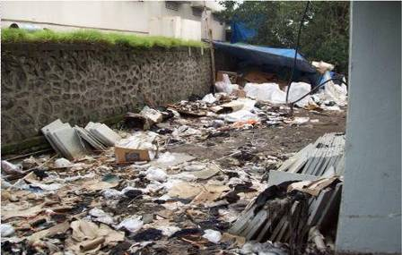
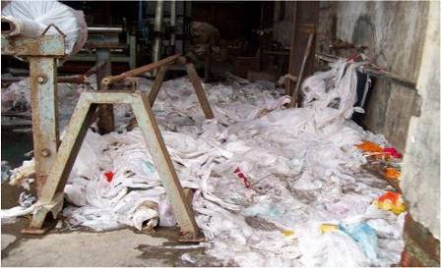
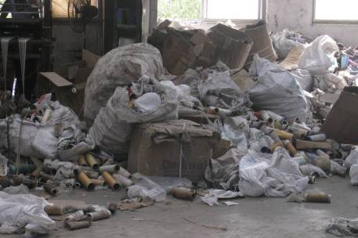
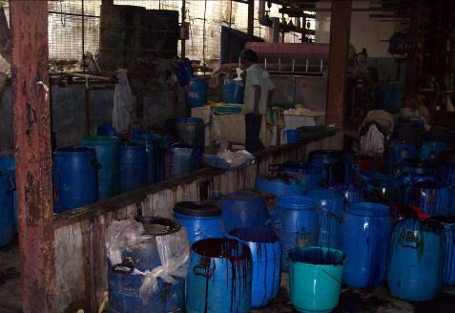
Exhibit 3: Many parts of these Indian plants were dirty and unsafe
Garbage outside the plant
Garbage inside a plant
Flammable garbage in a plant
Chemicals without any covering

Slide 14
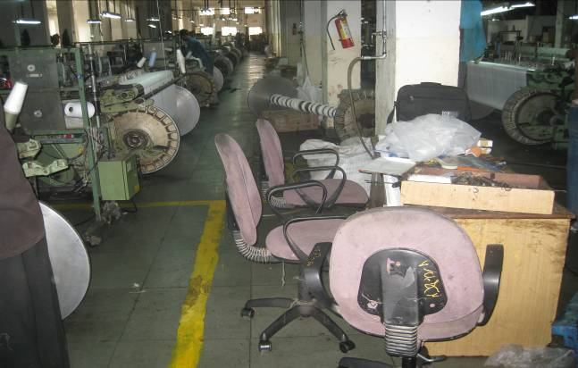
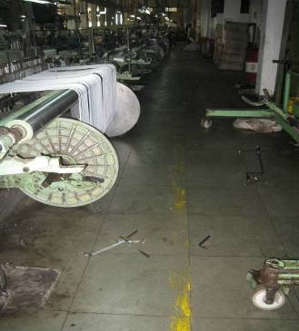
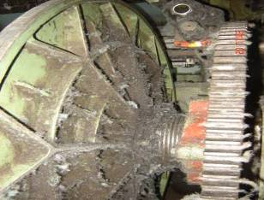
Exhibit 4: The plant floors were often disorganized and aisles blocked
Instrument not removed after use, blocking hallway.
Old warp beam, chairs and a desk obstructing the plant floor
Dirty and poorly maintained machines
Tools left on the floor after use

Slide 15
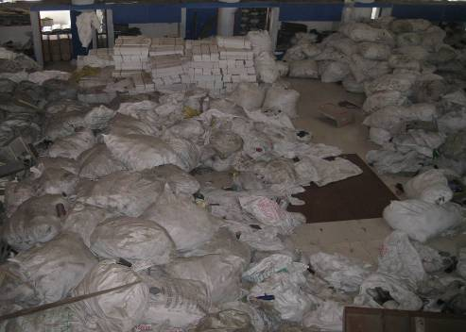
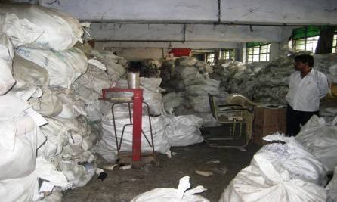
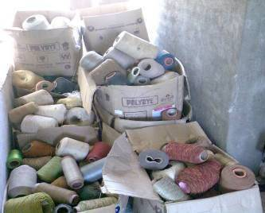
Exhibit 5: The inventory rooms had months of excess yarn, often without any formal storage system or protection from damp or crushing
Yarn without labeling, order or damp protection
Yarn piled up so high and deep that access to back sacks is almost impossible
Different types and colors of yarn lying mixed
A crushed yarn cone, which is unusable as it leads to irregular yarn tension

Slide 16
Management practices before and after treatment
Performance of the plants before and after treatment
Why were these practices not introduced before?
16

Slide 17
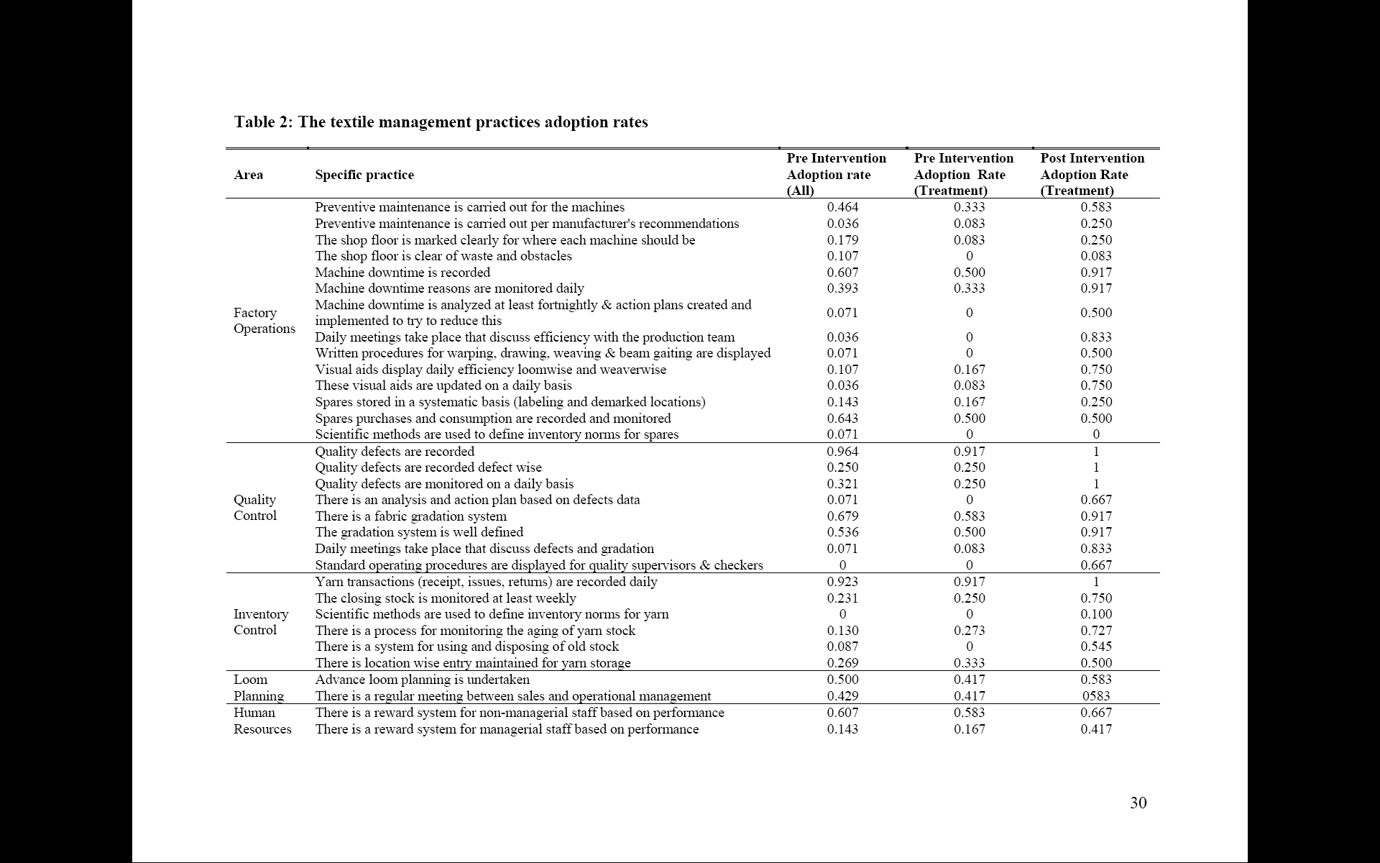
Intervention aimed to improve 38 core textile management practices in 5 areas
Targeted practices in 5 areas: operations, quality, inventory, HR and sales & orders

Slide 18
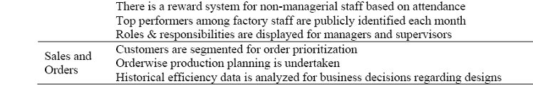
Intervention aimed to improve 38 core textile management practices in 5 areas
Targeted practices in 5 areas: operations, quality, inventory, HR and sales & orders

Slide 19
Adoption of the 38 management practices over time
.6
Treatment plants
.5
Control plants
Share of 38 practices adopted
.4
Non-experimental plants in treatment firms
.3
.2
-10
-8
-6
-4
-2
0
2
4
6
8
10
12
Months after the diagnostic phase
Months after the start of the diagnostic phase

Slide 20
Management practices before and after treatment
Performance of the plants before and after treatment
Why were these practices not introduced before?

Slide 21
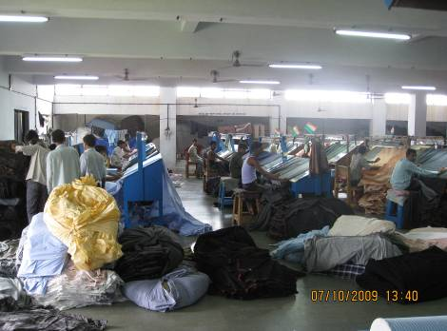
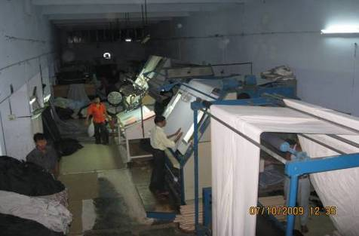
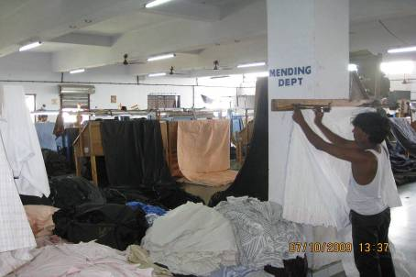
Poor quality meant 19% of manpower went on repairs
Large room full of repair workers (the day shift)
Workers spread cloth over lighted plates to spot defects
Defects are repaired by hand or cut out from cloth
Defects lead to about 5% of cloth being scrapped
Notes:
Above-left and right: mending department, Riviera Fashions. Below-left: mending department, Mahajan silk mills.
21

Slide 22
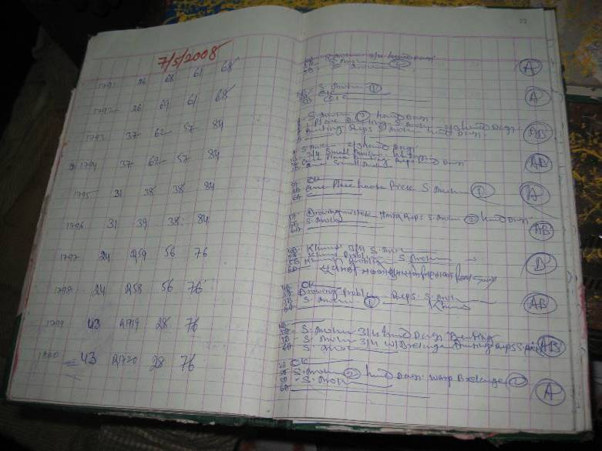
Previously mending was recorded only to cross-check against customers’ claims for rebates
Notes:
22

Slide 23
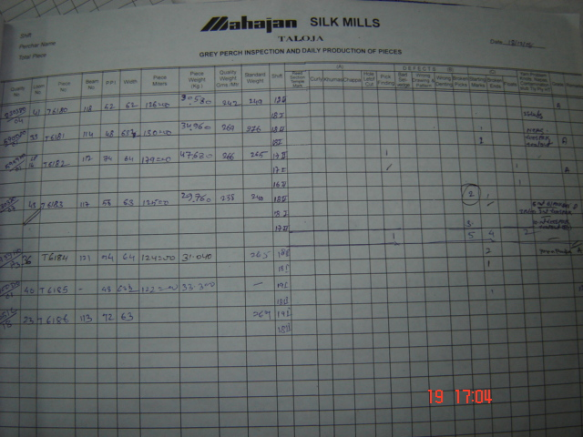
Now mending is recorded daily in a standard format, so it can analyzed by loom, shift, design & weaver
Notes:
23

Slide 24
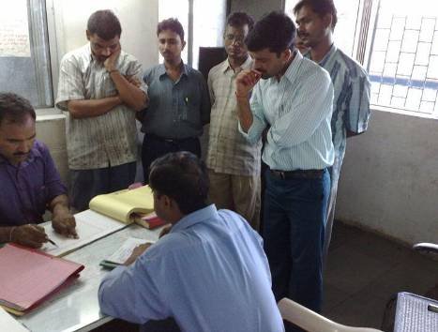
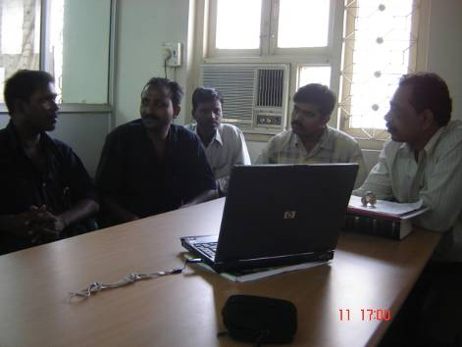
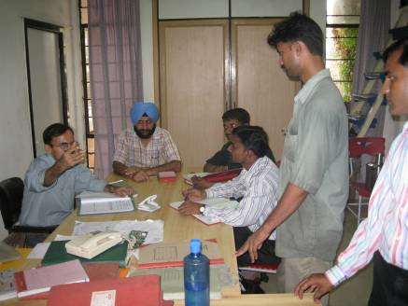
The quality data is now collated and analyzed as part of the new daily production meetings
Plant managers meet with heads of departments for quality, inventory, weaving, maintenance, warping etc.

Slide 25
Quality improved significantly in treatment plants
Control plants
Quality defects index
(higher score=lower quality)
Treatment plants
Weeks after the start of the experiment
Note: solid lines are point estimates, dashed lines are 95% confidence intervals

Slide 26
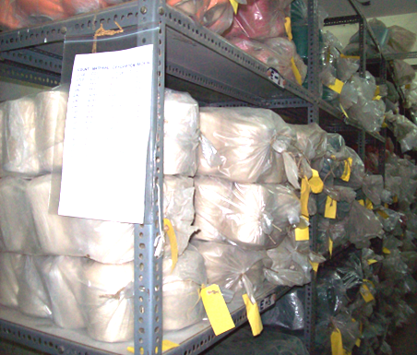
Organizing and racking inventory enables firms to substantially reduce capital stock
Stock is organized, labeled, and entered into the computer with details of the type, age and location.

Slide 27
Inventory fell in treatment plants
Control plants
Yarn inventory
Treatment plants
Weeks after the start of the experiment
Note: solid lines are point estimates, dashed lines are 95% confidence intervals

Slide 28
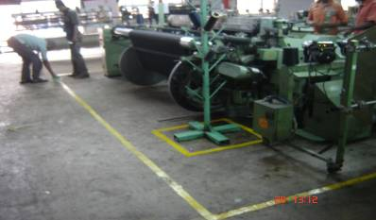
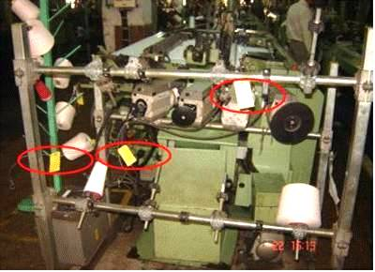
Many treated firms have also introduced basic initiatives (called “5S”) to organize the plant floor
Marking out the area around the model machine
Snag tagging to identify the abnormalities

Slide 29
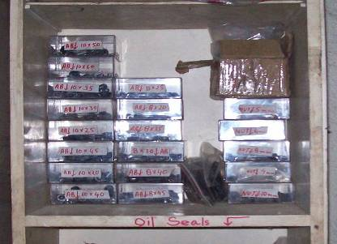
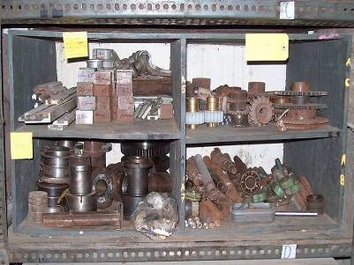
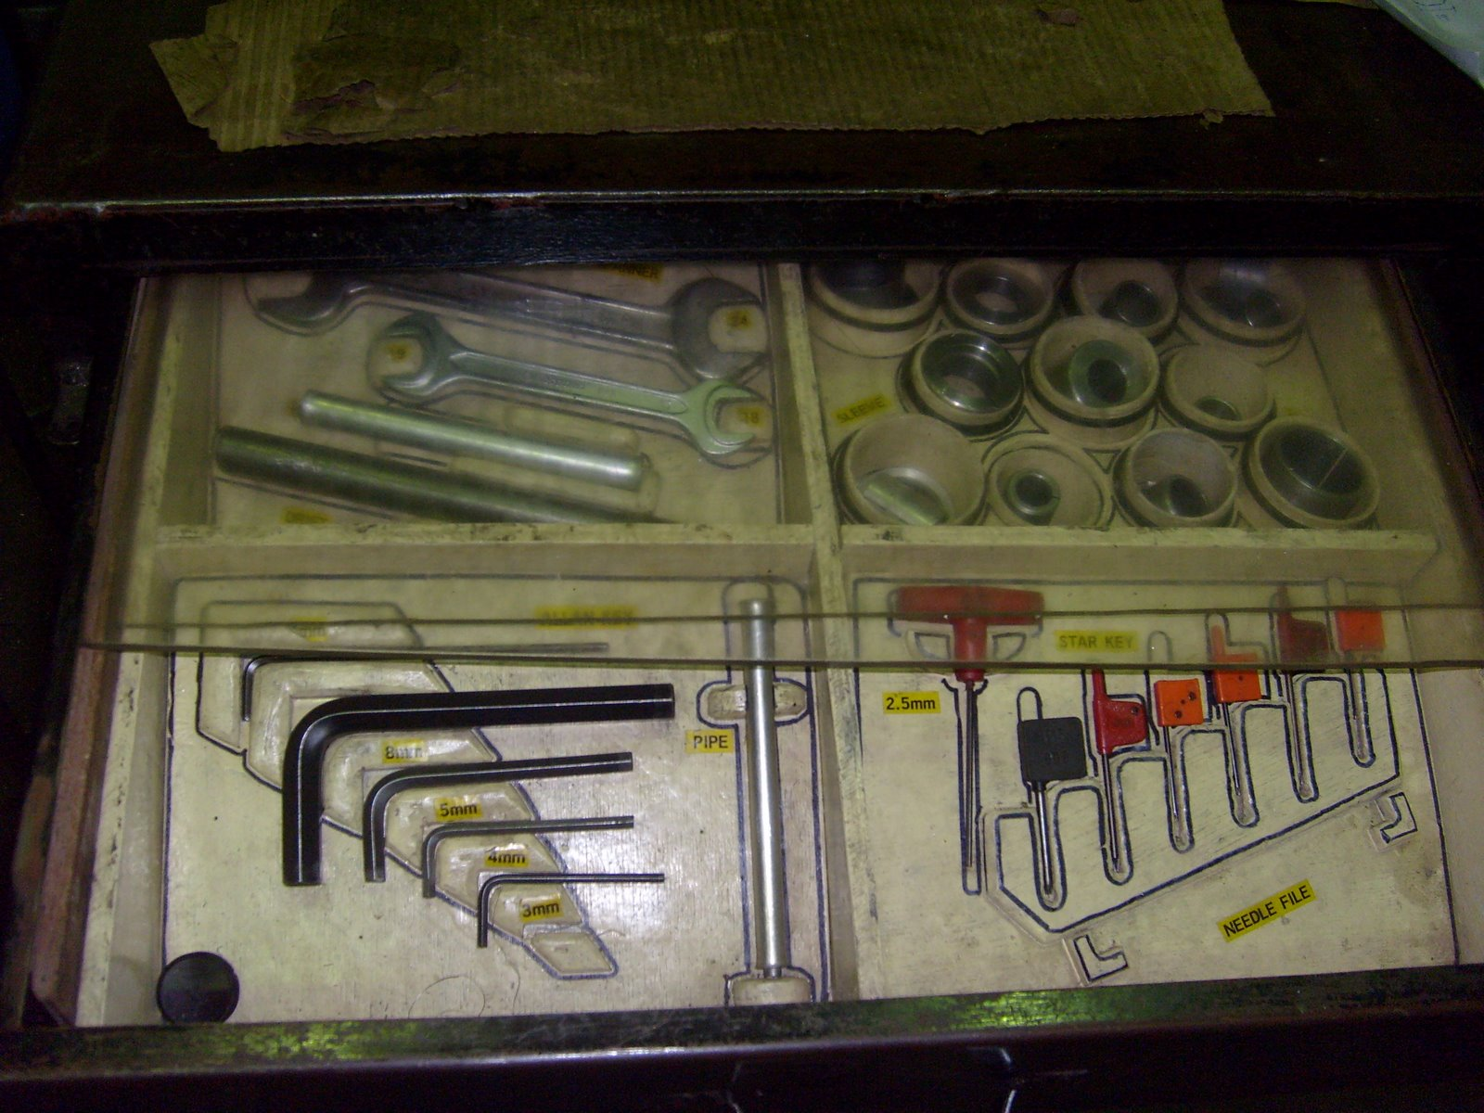
Spare parts were also organized, reducing downtime (parts can be found quickly)
Nuts & bolts
Spare parts
Tools

Slide 30
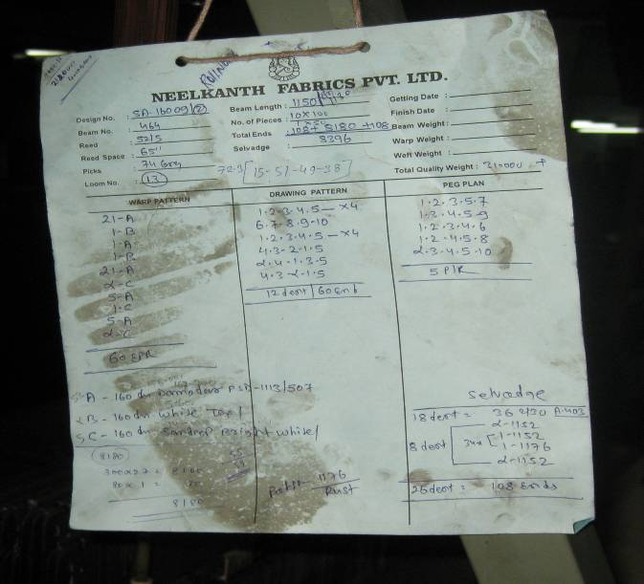
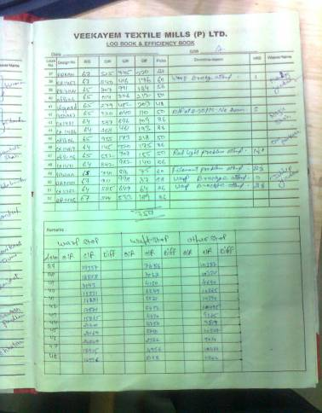
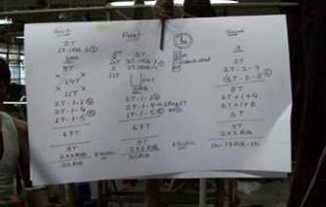
Production data is now collected in a standardized format, for discussion in the daily meetings
After
(standardized, so easy to enter daily into a computer)
Before
(not standardized, on loose pieces of paper)

Slide 31
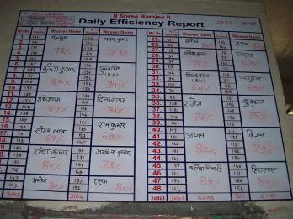
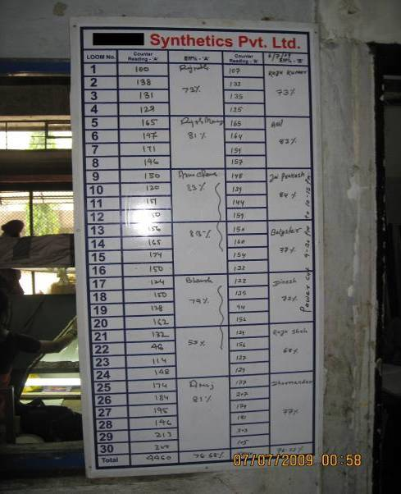
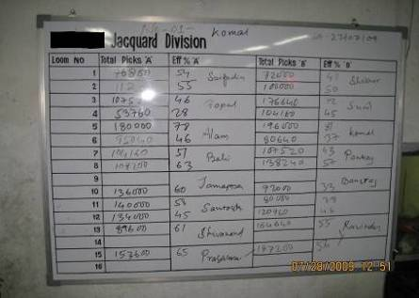
Daily performance boards have also been put up, with incentive pay for employees based on this

Slide 32
Productivity rose in treatment plants vs controls
Treatment plants
Total factor productivity
Control plants
Weeks after the start of the experiment
Note: solid lines are point estimates, dashed lines are 95% confidence intervals

Slide 33
Management practices before and after treatment
Performance of the plants before and after treatment
Why were these practices not introduced before?
33

Slide 34
Why doesn’t competition fix badly managed firms?
Reallocation appears limited: Owners take all decisions as they worry about managers stealing. But owners time is constrained – they already work 72.4 hours average a week – limiting growth.
As a result firm size is more linked to number of male family members (corr=0.689) than management scores (corr=0.223)
Entry appears limited: capital intensive due to minimum scale (for a warping loom and 30 weaving looms at least $1m)
Trade is restricted: 50% tariff on fabric imports from China

Slide 35
Why don’t these firms improve themselves (even worthwhile reducing costs for a monopolist…)?
Asked the consultants to investigate the non-adoption of each of the 38 practices, in each plant, every other month
Did this by discussion with the owners, managers, observation of the factory, and from trying to change management practices.
Find this is primarily an information problem
- Wrong information (do not believe worth doing)
- No information (never heard of the practices)
35

Slide 36
Summary
Management matters in Indian firms – large impacts on productivity and profitability from more modern practices
- Similar to Gokaldas, Danaher and Virginia Mason
A primary reason for bad management appears to be lack of information, which limited competition allows to persist

Slide 37
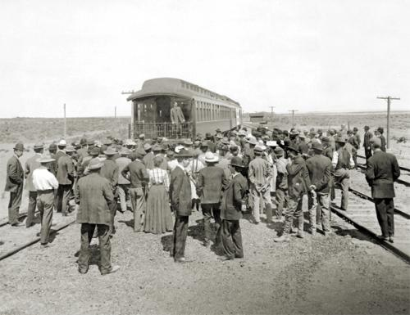
Currently looking at demonstration projects
Classic examples include Oregon Agricultural Demonstration Train (pictured), with other famous examples such as the boll-weevil project

Slide 38
Experiments in India
Experiments in China

Slide 39
Does Working from Home Work?
Evidence from a Corporate Experiment
Nick Bloom (Stanford)
James Liang (Ctrip & Stanford)
John Roberts (Stanford)
Zihchun Jenny Ying (Stanford)

Slide 40
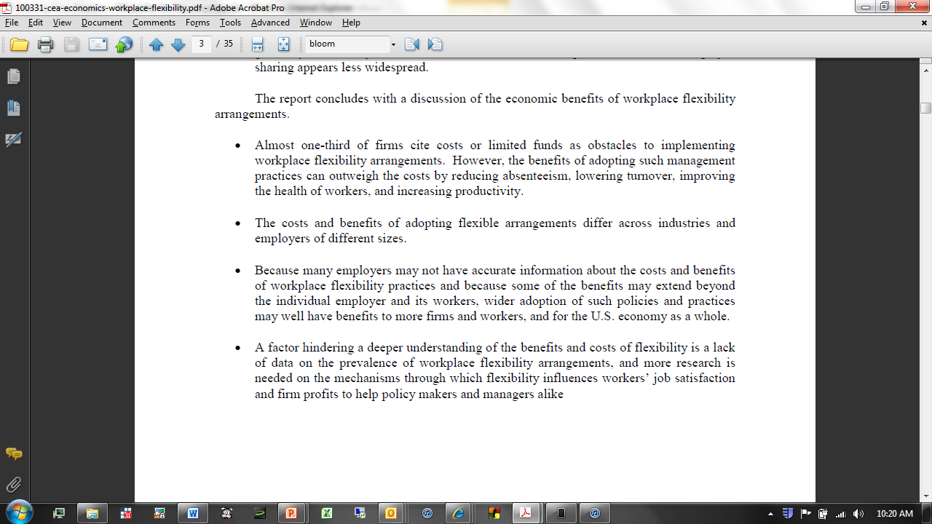
Working from home spreading rapidly
20 million people in US report working from home at least once per week, and rising by about 6% a year
But no hard evidence on its impact:
Source: Council of Economic Advisors (2010) “Report on work-life balance”, Executive Summary

Slide 41
As a results firms seem unsure about the costs and benefits of working from home
Allowing working from home is quite recent with a wide spread of actual practices
  e.g. American and Jet Blue have home working, Delta and Continental have none, and United is experimenting
So our firm decided to experiment on two divisions before rolling this out, which has two advantages:
  Test in advance (avoid big mistakes)
  Drive roll-out (have hard evidence to persuade managers)

Slide 42
Background on the experiment
Impact on the firm
Impact on the employees
Learning and roll-out

Slide 43
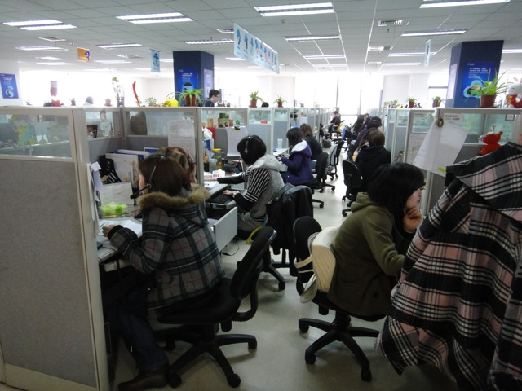
Chinese multinational decided to experiment with WFH
CTrip, China’s largest travel-agent (13,000 employees, and $5bn value on NASDAQ) runs call centers in Shanghai & Nan Tong
43
Notes:
Average age is 23, 68% are women, and all have high school but only 39% have tertiary education. Only 15% are married, 9% have children.

Slide 44
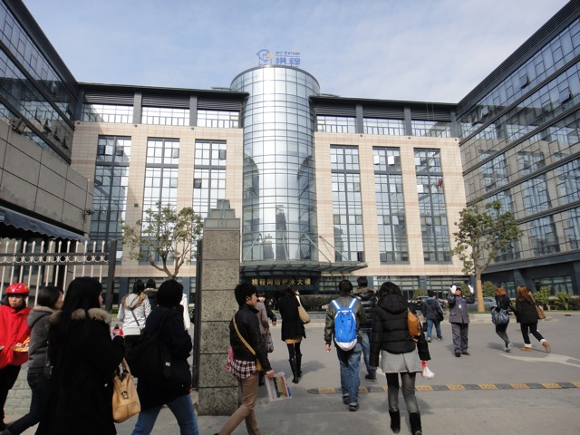
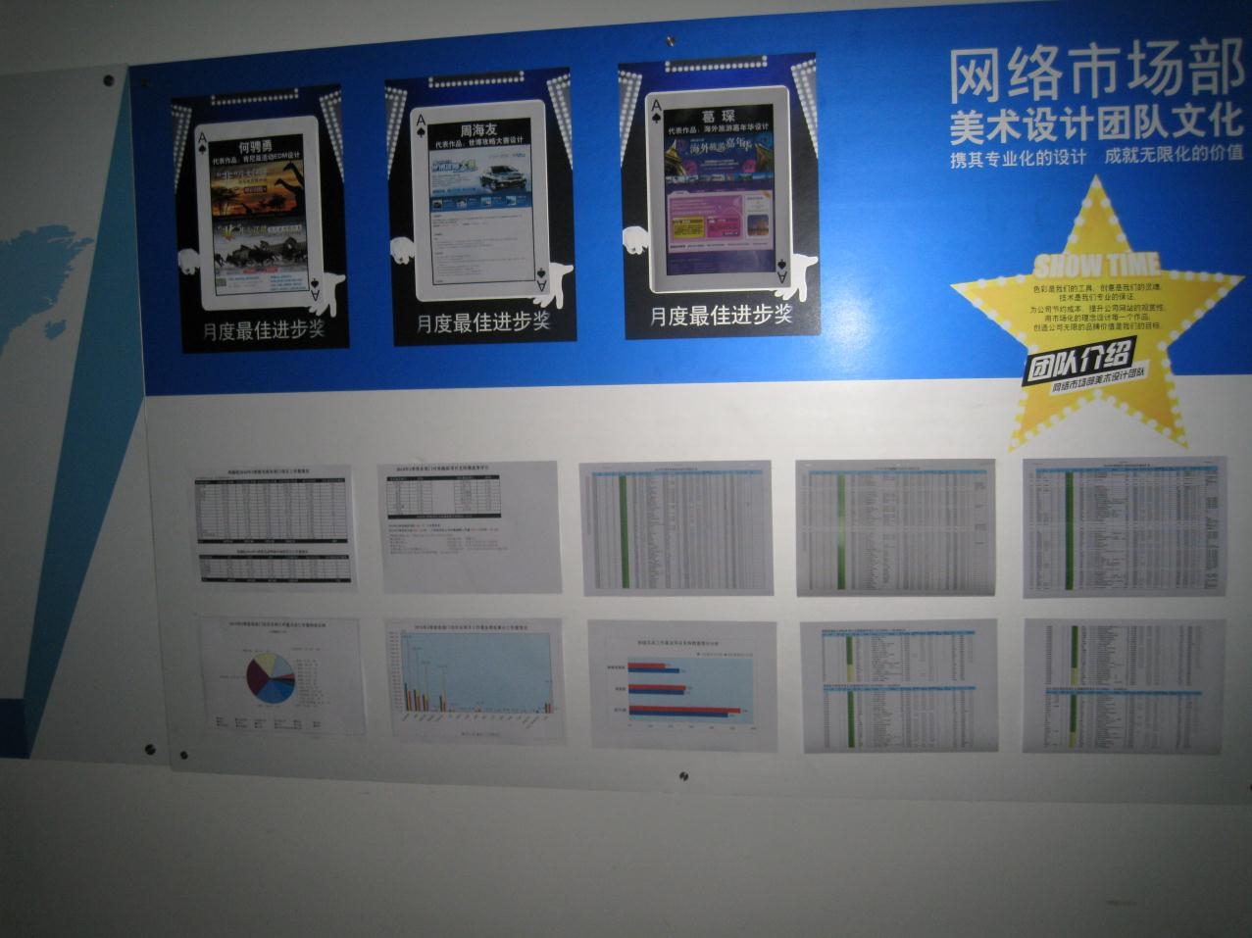
CTrip was co-founded by James Liang, ex-CEO and current Chairman (and a Stanford GSB Phd Student)
James and other co-founders are ex-Oracle so US management style and data focused (great for measuring outcomes)
Also having James Liang as a co-author means we have insight into management rationale for the experiment and roll-out

Slide 45
The experimental details
Experiment takes place in airfare and ticket departments in the Shanghai office. They take calls and make bookings
Employees work 5-shifts a week in teams of about 15 people plus a manager. Hours are fixed by team in advance
Treatment works 4 shifts a week at home and one shift a week (all at the same time) in the office for 9 months.
Of the 996 employees, 508 wanted to take part. Of those 255 qualified (had own-room and 6+ months experience)
Then ran the lottery and even birthdays within the 255 won (became treatment WFH) and odd stayed as before

Slide 46
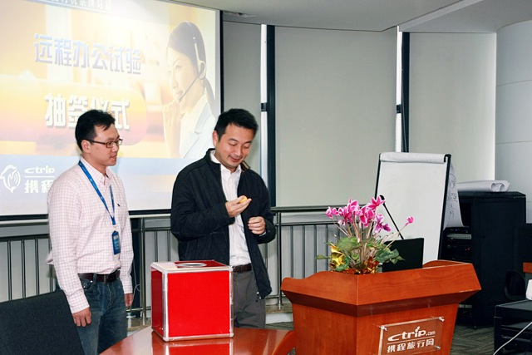

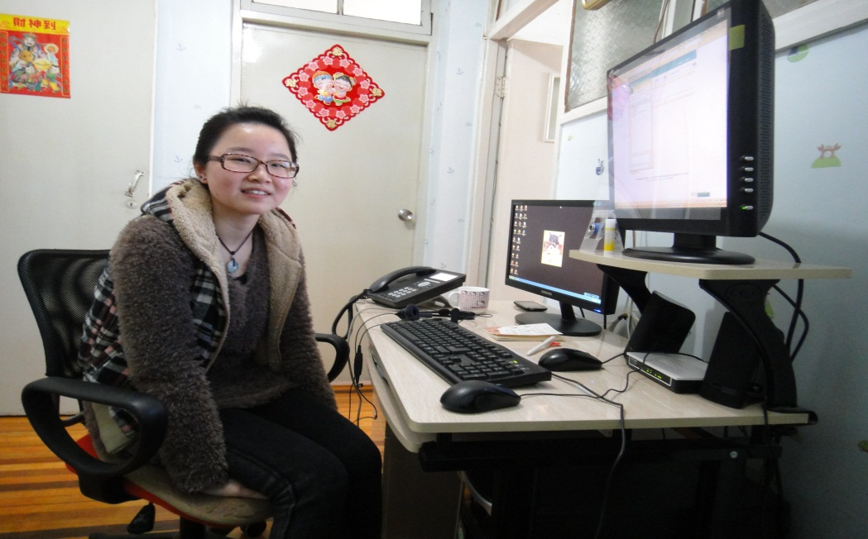
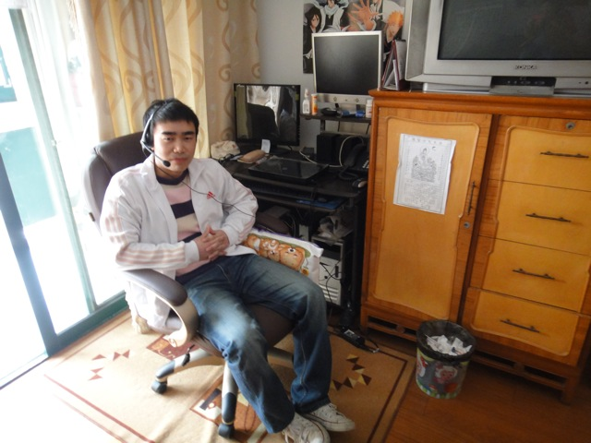
Individuals randomized to be allowed to work from by date of birth (even allowed home, odd not)
Lottery over even/odd treatment choice
Working at Home
Working at home
Working at Home

Slide 47
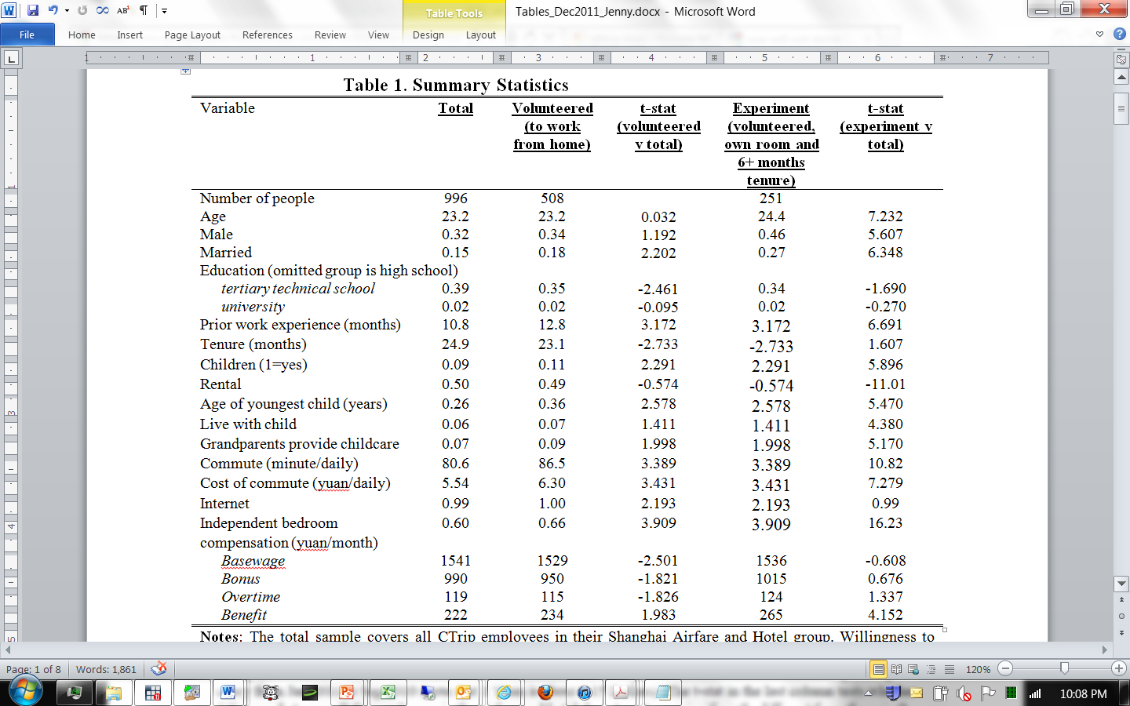
Volunteers were more likely to be married, have worked more before joining the firm, have kids, & commute further

Slide 48
Figure 1: Compliance was about 90%
Experiment starts, December 6th 2010
Experiment ends, August 31st
(odd)
(even)

Slide 49
Background on the experiment
Impact on the Firm
Impact on the employees
Learning and roll-out

Slide 50
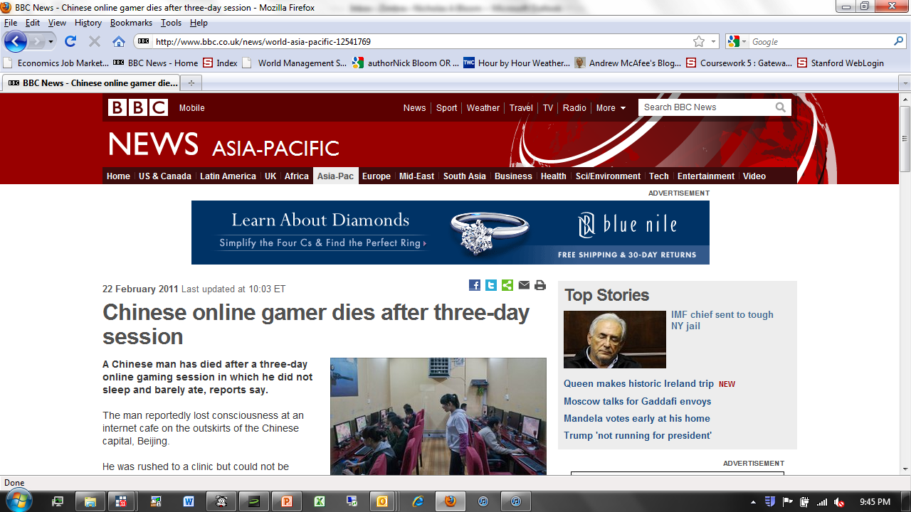
My prior for the impact on worker performance was negative, in part because of stories like this

Slide 51
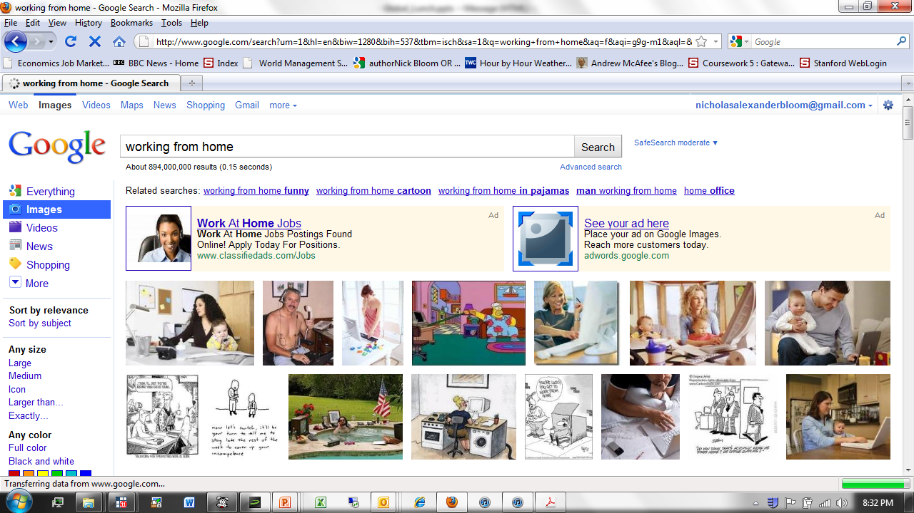
And the perception of working from home in the US also seems poor - e.g. top Google image search

Slide 52
In fact calls rose by 11.7% when working at home

Slide 53
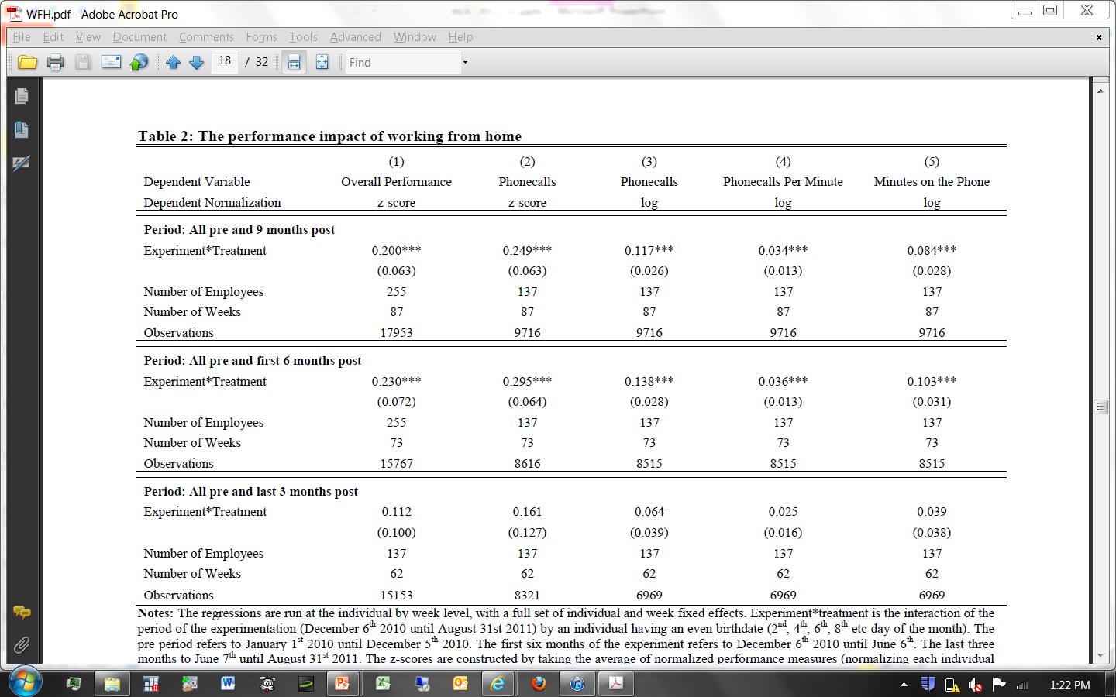
Working from home led to 11.7% more calls, 3.4% from more calls taken per minute and 8.4% from more minutes on the phone
All regressions include a full set of individual and week fixed effects, with standard errors clustered by individual. Treatment=even birthday.

Slide 54
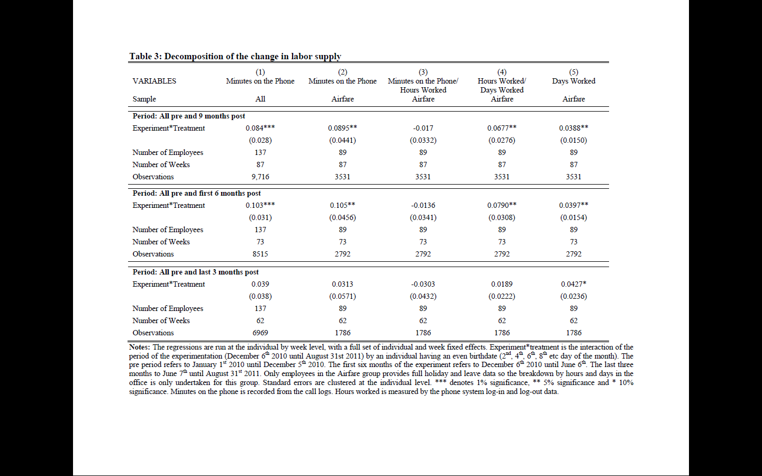
Minutes rose 8.4%, of which about 2/3 from employees working more hours per day (more punctual, shorter lunch breaks) and 1/3 from more days (less sick days)
All regressions include a full set of individual and week fixed effects, with standard errors clustered by individual. Treatment=even birthday. Hours worked from log-in data.

Slide 55
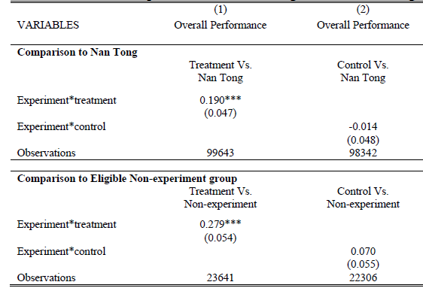
Also find no peer spillovers effects from office workers going home

Slide 56
Background on the experiment
Impact on the Firm
Impact on the employees
Learning and roll-out

Slide 57
Figure 4. Many employees seem to value working from home as attrition is significantly down

Slide 58

Self-reported survey welfare measures are also significantly higher for home workers
Airfare and Hotels group employees were administered regular surveys on their work satisfaction attitudes by a consultant psychologist.

Slide 59
Impact on Individual Performance
Impact on the Firm
Impact on the Employees
Learning and roll-out

Slide 60
Experiment so successful that CTrip is rapidly rolling out WFH across the firm
Profit increase per employee WFH about $2,000 per year:
  Rent: $1,200 per year
  Retention: $400 per year
  Labor costs: $300 per year
So two obvious questions:
  Why did CTrip not do this before?
  Why did other firms not do this (CTrip is first in China)?
Notes:
Output up by 12% as we find, labor (as measured in a Census) would be constant as shift length not changes (in reality workers may work more but less comute so labor time including commute probably less) and capital would fall (as need less office space while equipment about flat). While call centers are not used for standard TFP analysis it is clear any type of productivity measure of this would tend to rise if WFH was rolled-out.

Slide 61
Main reason is the firm did not know if working from home would work
Initially very concerned employees would shirk and quality would drop, so wanted to run an experiment first
Little external guidance – no other Chinese firms adopted this, and in the US no standard approach. e.g. in airline call centers Jet Blue at home, Delta in the office, United both
After running the experiment found employees improved across the board (even bottom 25%) and no quality drop

Slide 62

Also true that employees were uncertain and appear to learn over time
Initial take up rate 50%, with about 25% switching ex post
Notes:
Large number of employees switched preferences on WFH in two survey waves

Slide 63

Currently continuing to collect data and following longer run impact on promotions, recruitment and employee outcomes (even for those left the firm)
Notes:
Mention running survey to look at longer run impact on current and future work and home outcome like kids etc. See if the experiment has persistent impact upon individual choices. I would then leave this cartoon up long enough for everyone to read it….

Slide 64
Wrap up for the class and the course
There do seem to be a basic set of management practices for monitoring, targets and incentives that improve performance
Many organizations are not adopting these, particularly those facing little competition and with government/family ownership
This suggests huge opportunity for using management to change the world
One of the biggest obstacles in driving change is persuading people that these practices matter, for which case-studies, surveys and experiments all play a part

Slide 65

Some of this material is here, which we hope will be helpful www.worldmanagementsurvey.com

