Slide 1
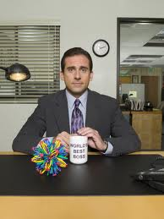
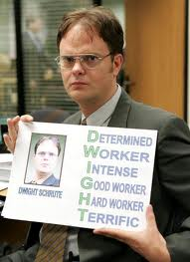
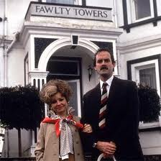
Management Practices in Europe, the US and Emerging Markets
Nick Bloom (Stanford Economics and GSB)
John Van Reenen (LSE and Stanford GSB)
Lecture 3: Management and firm Performance

Slide 2
Monitoring management practices
Some drivers of good management
Lincoln Electric
Incentives/People Management

Slide 3
Monitoring/Performance management
Today we will run through 5 dimensions on monitoring management (questions 1 to 6)
The concept is around the collection and use of information.
While the data we have shown is for manufacturing, these questions have been used in retail, hospitals, schools, healthcare clinics, tax collection agencies, nursing homes and law firms
3
Notes:
3

Slide 4
(3) Process problem documentation
Score | (1): No, process improvements are made when problems occur. | (3): Improvements are made in one week workshops involving all staff, to improve performance in their area of the plant | (5): Exposing problems in a structured way is integral to individuals’ responsibilities and resolution occurs as a part of normal business processes rather than by extraordinary effort/teams
4
Notes:
4

Slide 5
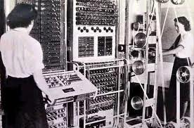
Setting up your clicker
Press “GO”
Then slowly press “0” and then “5” (channel is “05”)
Then slowly press “GO” again
A green light should appear signaling the clicker worked

Slide 6

(3) Process problem documentation
(1): No, process improvements are made when problems occur. | (3): Improvements are made in one week workshops involving all staff, to improve performance in their area of the plant | (5): Exposing problems in a structured way is integral to individuals’ responsibilities and resolution occurs as a part of normal business processes rather than by extraordinary effort/teams

Slide 7
The survey scores to question (3), process problem documentation – all countries, manufacturing
Average 3.13
All countries, manufacturing firms (100 to 5000 employees), 9840 observations

Slide 8
The survey scores to question (3), process problem documentation – US, manufacturing
Average 3.42
US, manufacturing firms (100 to 5000 employees),
1298 observations

Slide 9
The survey scores to question (3), process problem documentation – India, manufacturing
Average 2.64
India, manufacturing firms (100 to 5000 employees),
1137 observations

Slide 10
The survey scores to question (3), process problem documentation – US, Canada and UK, retail
Average 3.07
All countries, retail firms (100 to 5000 employees)
661 observations

Slide 11
The survey scores to question (3), process problem documentation – developed countries, hospitals
Average 3.04
Hospitals, Canada, France, Germany, Italy, Sweden, UK, US, 1183 observations

Slide 12
(4) Performance tracking
(1): Measures tracked do not indicate directly if overall business objectives are being met. Tracking is an ad-hoc process (certain processes aren’t tracked at all) | (3): Most key performance indicators are tracked formally. Tracking is overseen by senior management. | (5): Performance is continuously tracked and communicated, both formally and informally, to all staff using a range of visual management tools.

Slide 13
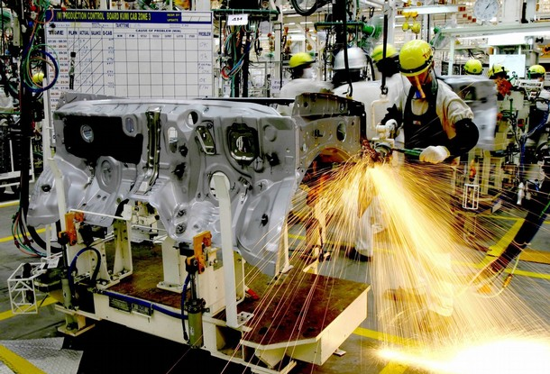
Examples of performance metrics – Toyota

Slide 14
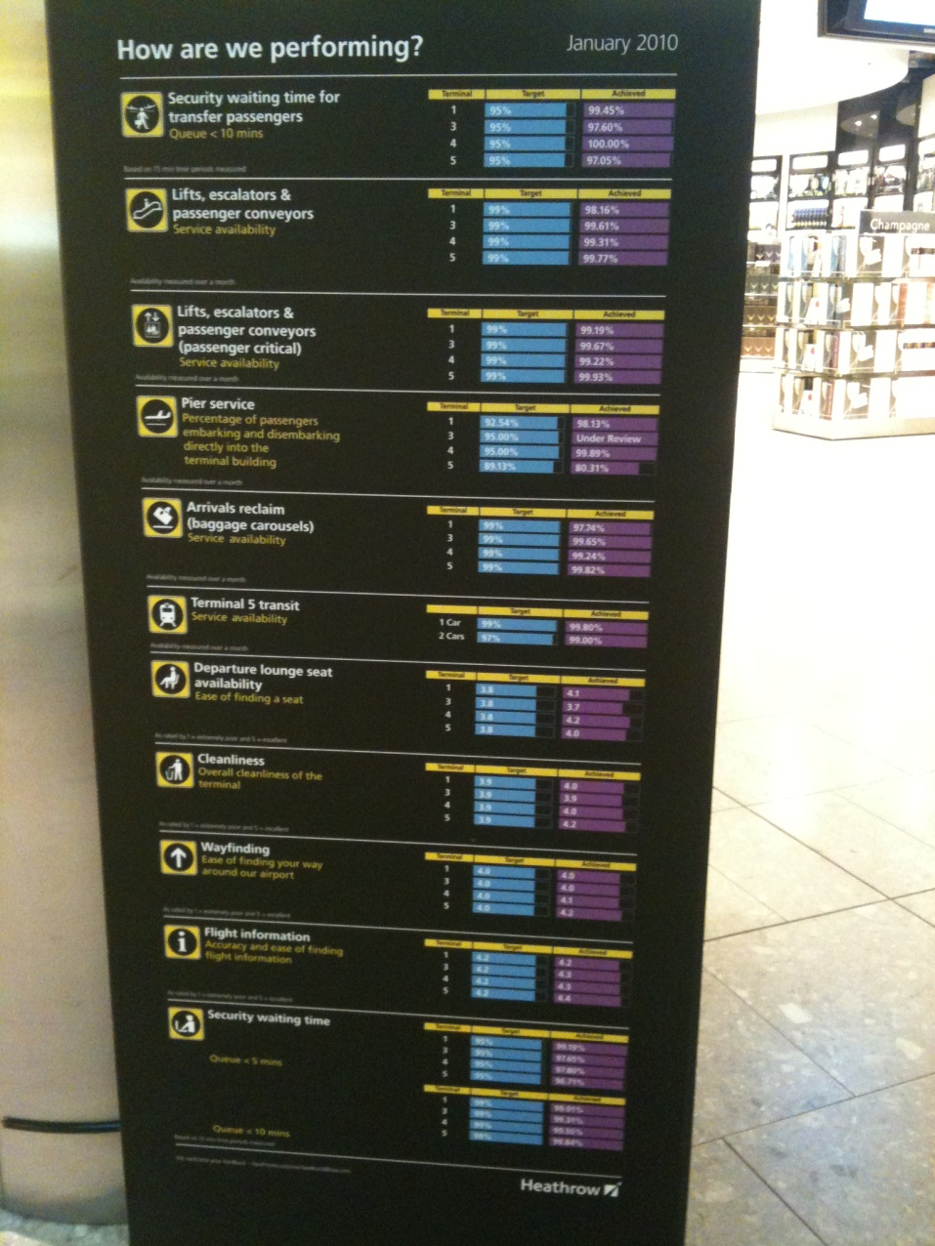
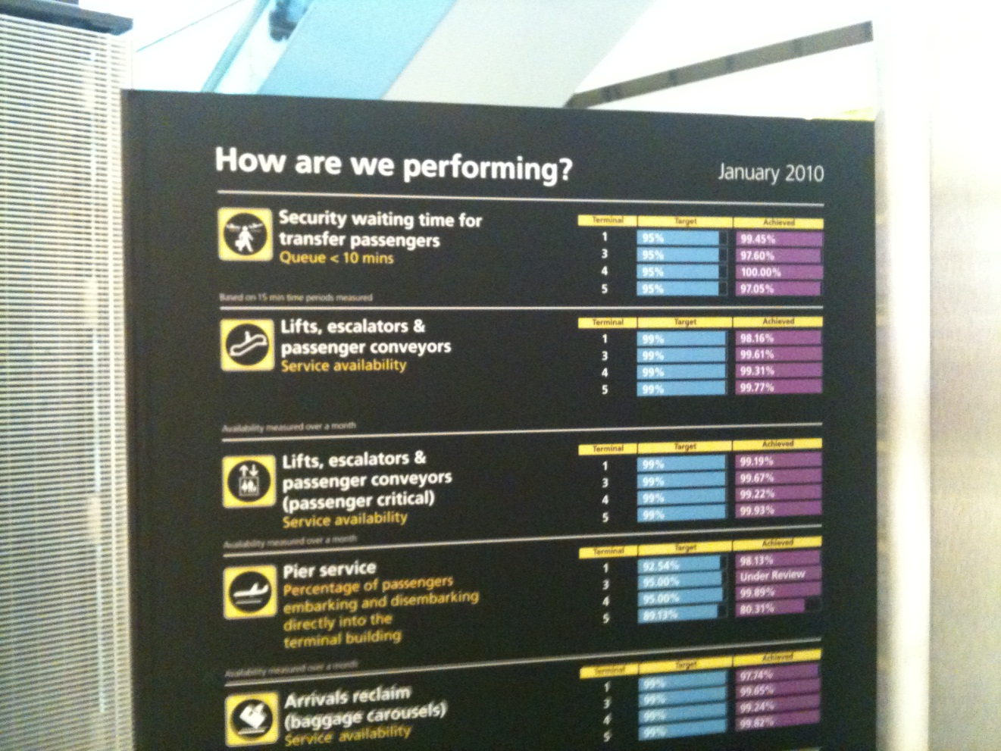
Examples of performance metrics - Heathrow

Slide 15
Performance tracking (4): all countries, manufacturing
Average 3.36
All countries, manufacturing firms (100 to 5000 employees), 9838 observations

Slide 16
(5) Performance review
Score | (1): Performance is reviewed infrequently or in an un-meaningful way e.g. only success or failure is noted. | (3): Performance is reviewed periodically with successes and failures identified. Results are communicated to senior management. No clear follow-up plan is adopted. | (5): Performance is continually reviewed, based on indicators tracked. All aspects are followed up ensure continuous improvement. Results are communicated to all staff
16
Notes:
16

Slide 17
(5) Performance review
(1): Performance is reviewed infrequently or in an un-meaningful way e.g. only success or failure is noted. | (3): Performance is reviewed periodically with successes and failures identified. Results are communicated to senior management. No clear follow-up plan is adopted. | (5): Performance is continually reviewed, based on indicators tracked. All aspects are followed up ensure continuous improvement. Results are communicated to all staff

Slide 18
Performance review (5): all countries, manufacturing
Average 3.33
All countries, manufacturing firms (100 to 5000 employees), 9827 observations

Slide 19
Monitoring management practices
Some “drivers” of good management
Lincoln Electric
Incentives/People Management

Slide 20
(5) Performance review
Score | (1): Performance is reviewed infrequently or in an un-meaningful way e.g. only success or failure is noted. | (3): Performance is reviewed periodically with successes and failures identified. Results are communicated to senior management. No clear follow-up plan is adopted. | (5): Performance is continually reviewed, based on indicators tracked. All aspects are followed up ensure continuous improvement. Results are communicated to all staff
20
Notes:
20

Slide 21
COMPETITION & MODELS OF MANAGEMENT
Various ways that competition may influence management
  Selection – badly run firms morel likely to exit
  Effort – forces badly run firms to try harder to survive
We find competition is strongly linked with better management through a mixture of selection & effort

Slide 22
Competition IMPROVES Management
Manufacturing and Retail (the private sector)
Hospitals and Schools
(the public sector)
3
2.8
2.75
2.95
Management score
2.7
2.9
2.65
2.85
2.6
2.8
2.55
0
1
2 to 4
5+
0
1
2 to 4
5+
Number of Reported Competitors
Sample of 9469 manufacturing and 661 retail firms (private sector panel) and 1183 hospitals and 780 schools (public sector panel). Reported competitors defined from the response to the question “How many competitors does your [organization] face?”

Slide 23
FAMILY FIRMS AND MODELS OF MANAGEMENT PRACTICES
Impact of family firms depends on involvement
  Ownership but not management probably positive
    Concentrated ownership so better monitoring
  Management probably negative
    Smaller pool to select CEO from
    Possible “Carnegie” effect on future CEO’s
    Less career incentive for non-family managers
Notes:
Bandiera et al find that family ownership helps reduce CEO slack (time with outsiders) but NOT when family member IS CEO

Slide 24
Family firms & government owned firms typically have the worst management
Dispersed Shareholders
Private Equity
Family owned, non-family CEO
Managers
Private Individuals
Government
Family owned, family CEO
Founder owned, founder CEO
2.7
2.8
2.9
3
3.1
3.2
Management score (by ownership type)
Management scores after controlling for country, industry and number of employees. Data from 9085 manufacturers and 658 retailers. “Founder owned , founder CEO” firms are those still owned and managed by their founders. “Family firms” are those owned by descendants of the founder “Dispersed shareholder” firms are those with no shareholder with more than 25% of equity, such as widely held public firms.

Slide 25
Education for Non-Managers and Managers Appear Linked to Better Management
Non-managers
Managers
3.3
3.1
3.2
3
3.1
2.9
3
Management score
2.8
2.9
2.7
2.8
2.7
2.6
2.6
2.5
0
1 to 10
11 to 25
26 to 50
50+
0
1 to 10
11 to 25
26 to 50
50+
Percentage of employees with a college degree (%)
Sample of 8,032 manufacturing and 647 retail firms.

Slide 26
My favourite quotes
The traditional British Chat-Up
[Male manager speaking to an Australian female interviewer]
Production Manager: “Your accent is really cute and I love the way you talk. Do you fancy meeting up near the factory?”
Interviewer “Sorry, but I’m washing my hair every night for the next month….”

Slide 27
My favourite quotes
The traditional Indian Chat-Up
Production Manager: “Are you a Brahmin?’
Interviewer “Yes, why do you ask?”
Production manager “And are you married?”
Interviewer “No?”
Production manager “Excellent, excellent, my son is looking for a bride and I think you could be perfect. I must contact your parents to discuss this”

Slide 28
Monitoring management practices
Some “drivers” of good management
Lincoln Electric
Incentives/People Management practices

Slide 29
Q1 What types of performance incentives does Lincoln Electric provide, and how have these helped to drive performance

Slide 30
What are the downsides of Lincoln Electrics performance incentives – try to relate this to experiences you have had with strong performance incentives

Slide 31
Do you think Lincoln electrics incentive systems would work outside the US? Prepare to discuss their success/failure in another country you know.

Slide 32
BACK UP

Slide 33
(6) Performance dialogue
(1): The right data or information for a constructive discussion is often not present or conversations overly focus on data that is not meaningful. Clear agenda is not known and purpose is not stated explicitly | (3): Review conversations are held with the appropriate data and information present. Objectives of meetings are clear to all participating and a clear agenda is present. Conversations do not, as a matter of course, drive to the root causes of the problems. | (5): Regular review/performance conversations focus on problem solving and addressing root causes. Purpose, agenda and follow-up steps are clear to all. Meetings are an opportunity for constructive feedback and coaching.

Slide 34
Performance dialogue (6): all countries, manufacturing
Average 3.19
All countries, manufacturing firms (100 to 5000 employees), 9794 observations

Slide 35
(1) Modern manufacturing, introduction
Score | (1): Other than JIT delivery from suppliers few modern manufacturing techniques have been introduced, (or have been introduced in an ad-hoc manner) | (3): Some aspects of modern manufacturing techniques have been introduced, through informal/isolated change programs | (5): All major aspects of modern manufacturing have been introduced (Just-in-time, autonomation, flexible manpower, support systems, attitudes and behaviour) in a formal way
35
Notes:
35

Slide 36
Modern manufacturing (1): all countries, manufacturing
Average 2.77
All countries, manufacturing firms (100 to 5000 employees), 9830 observations

Slide 37
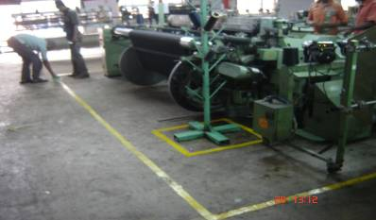
Marking out a factory floor

Slide 38
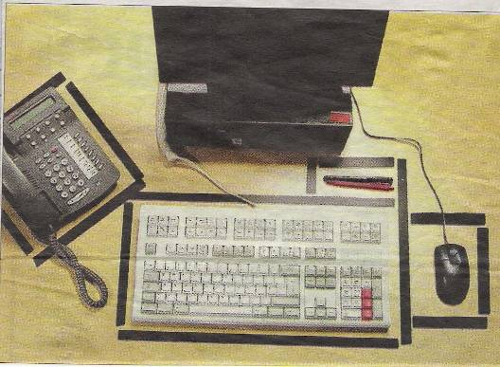
Why Lean is not always good….
The £7 million guide to a tidy desk, London Times, January 5, 2007
Red tape has given way to black marker tape for thousands of bemused civil servants as part of a £7 million paperclip revolution aimed at ensuring that they keep the tools of their trade in the right place. Office workers have been given the tape to mark out where they should put their pens and pencils, their computer keyboards and to indicate where to place their phones.
National Insurance staff have been chosen as guinea-pigs for the latest phase of the “Lean” programme brought in by the logistics consultants Unipart. The programme prohibits workers from keeping personal items on their desks.

Slide 39
(13) Managing human capital
Score | (1): Senior management do not communicate that attracting, retaining and developing talent throughout the organization is a top priority | (3): Senior management believe and communicate that having top talent throughout the organization is a key way to win | (5): Senior managers are evaluated and held accountable on the strength of the talent pool they actively build

Slide 40
(13) Managing human capital
(1): Senior management do not communicate that attracting, retaining and developing talent throughout the organization is a top priority | (3): Senior management believe and communicate that having top talent throughout the organization is a key way to win | (5): Senior managers are evaluated and held accountable on the strength of the talent pool they actively build

Slide 41
The survey scores to question (13), managing human capital – all countries, manufacturing
Average 2.43
All countries, manufacturing firms (100 to 5000 employees), 9806 observations

Slide 42
(7) Consequence management
Score | (1): Failure to achieve agreed objectives does not carry any consequences | (3): Failure to achieve agreed results is tolerated for a period before action is taken. | (5): A failure to achieve agreed targets drives retraining in identified areas of weakness or moving individuals to where their skills are appropriate

Slide 43
(7) Consequence management
(1): Failure to achieve agreed objectives does not carry any consequences | (3): Failure to achieve agreed results is tolerated for a period before action is taken. | (5): A failure to achieve agreed targets drives retraining in identified areas of weakness or moving individuals to where their skills are appropriate

Slide 44
The survey scores to question (7), consequence management – all countries, manufacturing
Average 3.56
All countries, manufacturing firms (100 to 5000 employees), 9820 observations

